Slide 1

Grouping Data and Loops Python
MTH 564 – Mathematical Modeling

Slide 2

Installation of Python
Lists in Python
Lists
Ordered – the order of the list matters
Members are indexed starting at 0
Changeable – you can change elements or add to the list
Duplicates Allowed – you can have the same element multiple times in a list
Square brackets are used to denote a list [ ]
Indexed starting at 0 – you can access individual elements
You can use the in keyword to see if an item is in a list.
The len function will tell you the number of elements in a list.
Example: lists.py

Slide 3
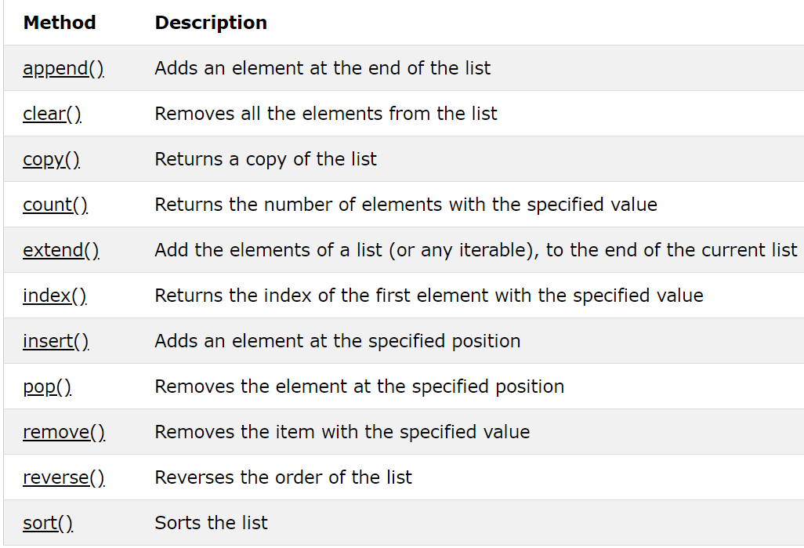
Built-in List Functions
Example:
listref.py

Slide 4
Installation of Python
Tuples in Python
Tuples
Ordered – the order of the tuple matters
Members are indexed starting at 0
Unchangeable – you can NOT change elements or add to the tuple
Duplicates Allowed – you can have the same element multiple times in a tuple
Parenthesis are used to denote a tuple ( )
Indexed starting at 0 – you can access individual elements
You can use the in keyword to see if an item is in a tuple.
The len function will tell you the number of elements in a tuple.
Example: tuples.py

Slide 5
Installation of Python
Sets in Python
Sets
Unordered – the order of the set does NOT matters
Changeable – you can change elements or add to the set
No Duplicates – you can NOT have the same element multiple times in a set
Braces are used to denote a set { }
Not Indexed – you can NOT access individual elements
You can use the in keyword to see if an item is in a set.
The len function will tell you the number of elements in a set.
There are functions for all your favorite set operations.
Example: sets.py

Slide 6
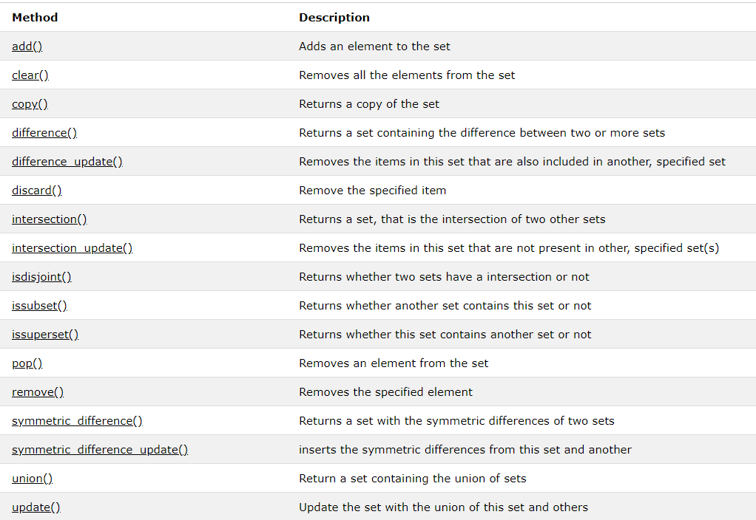
Built-in Set Functions
Example:
listref.py

Slide 7
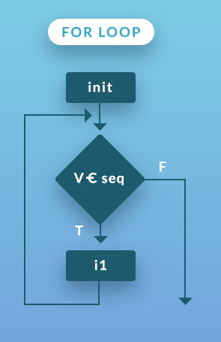
For Loops in Python
for v in seq:
statement1
statement2
….
Note
used to traverse a List, Set, Tuple, or String
code is executed for each element
colon : symbol and indentation are very important

Slide 8
Double For Loops in Python
for v1 in seq_1:
for v2 in seq_2:
statement_second_loop
statement_second_loop
….
statement_first_loop
statement_first_loop
….
Note: indentation tells you which statement get executed for the first or second loop
Example: forloop.py

Slide 9
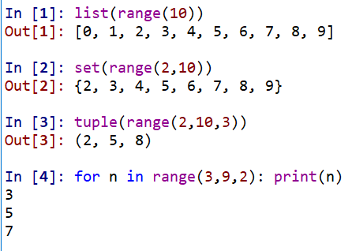
Range Function
range function: range(start, stop, increment)
returns a sequence of numbers starting at start, ending before stop, in step sizes of increment.
start and increment are optional; defaults are 0 and 1
used to quickly create list, sets, and tuples
used in for loops

Slide 10
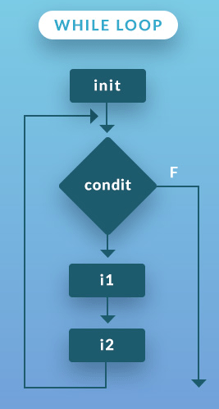
While Loops in Python
initialize variables
while boolean_condition:
statement1
statement2
….
statement (executed when Boolean False)
Note
Code block is executed at long as condition is True
colon : symbol and indentation are very important
Example: whileloop.py

